Slide 1
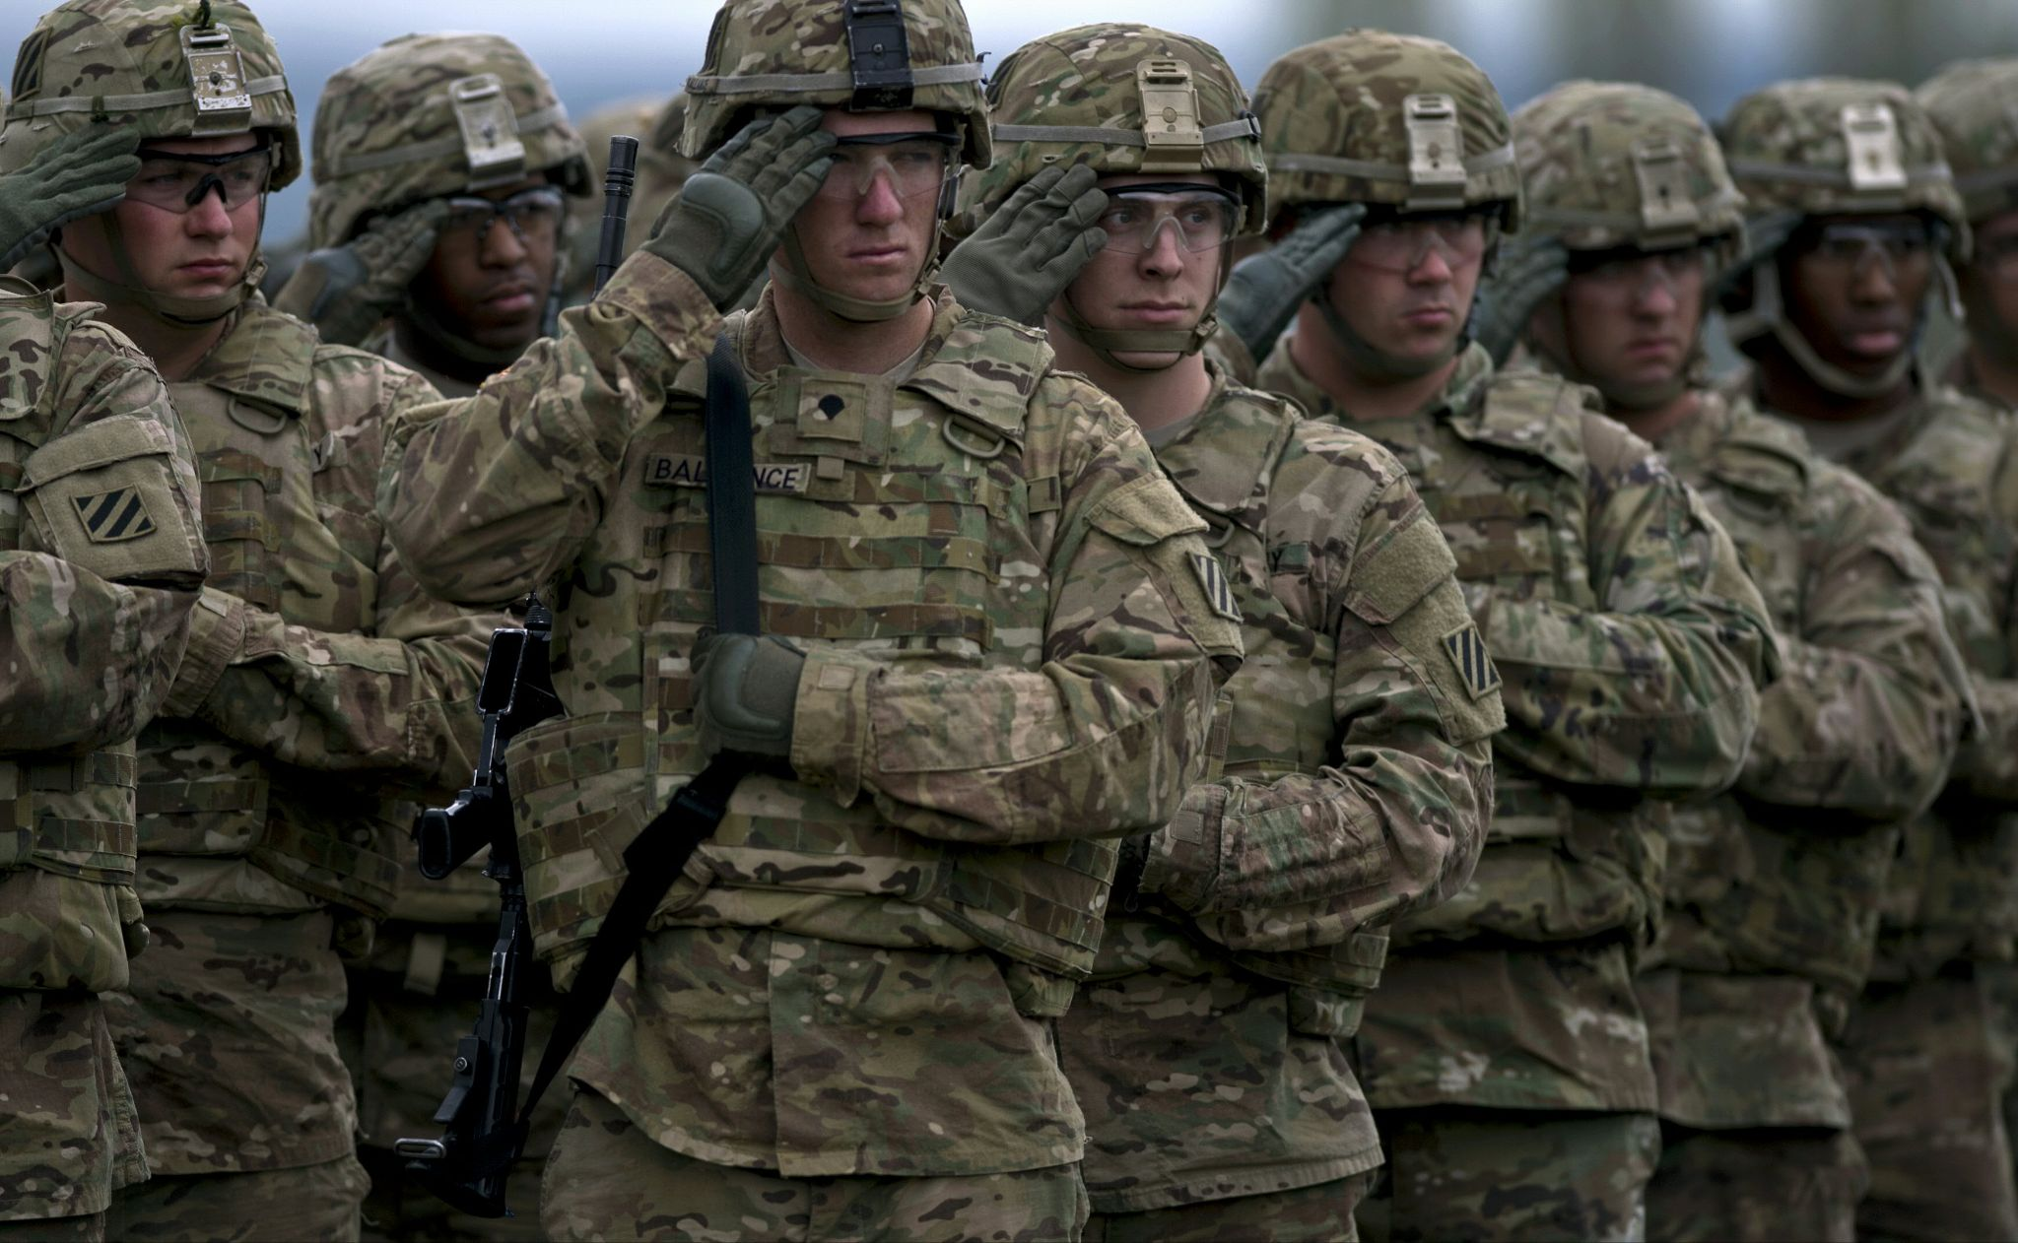
Soldier Demographics
A Capstone Project by Walter Castillo

Slide 2

About Me
Born in Honduras, March 6, 1998.
Joined the Army September 2017
Infantry Sergeant
Married
Junior in college pursuing a Computer Science Degree
Some hobbies of mine are computer games and golf.

Slide 3
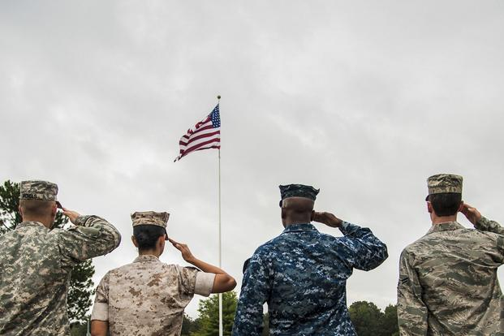
Why Knowing Service Member Demographics Matters
New Army Culture
What we can do
New Army, New Direction
Why Marital Status Matters
Different Status Different Needs
Notes:
The Army is moving in a new direction where its warfighting capabilities are becoming more focused on the soldier. Readiness is a huge importance to us as leaders of soldiers.
Knowing about things like soldiers marital status helps us better meet their needs. Married soldiers have special needs like housing, childcare and family counseling
As a single soldier it is easy to feel like you are missing out on benefits compared to married soldiers. I believe single soldiers have different needs which need to be fulfilled as much as married soldiers needs.

Slide 4
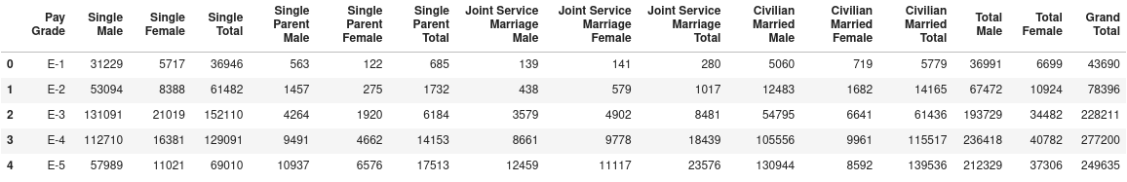
Looking Into The Data
Challenge 1
Challenge 3
Data acquired from Data.gov created in 2010
1.5 million active duty service members
The ‘Pay Grade’ column is categorical while the rest are numerical.
There was no data missing or nan’s.

Slide 5
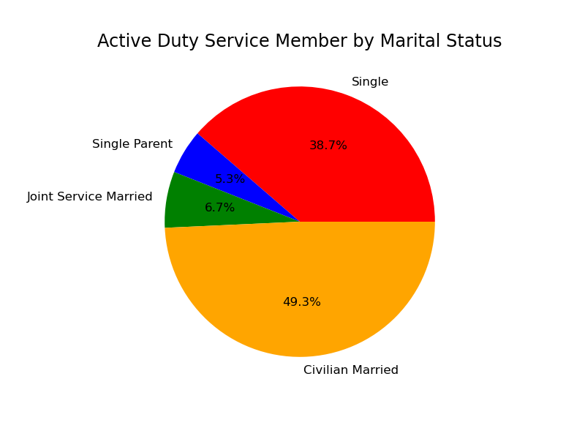
Data Exploring

Slide 6
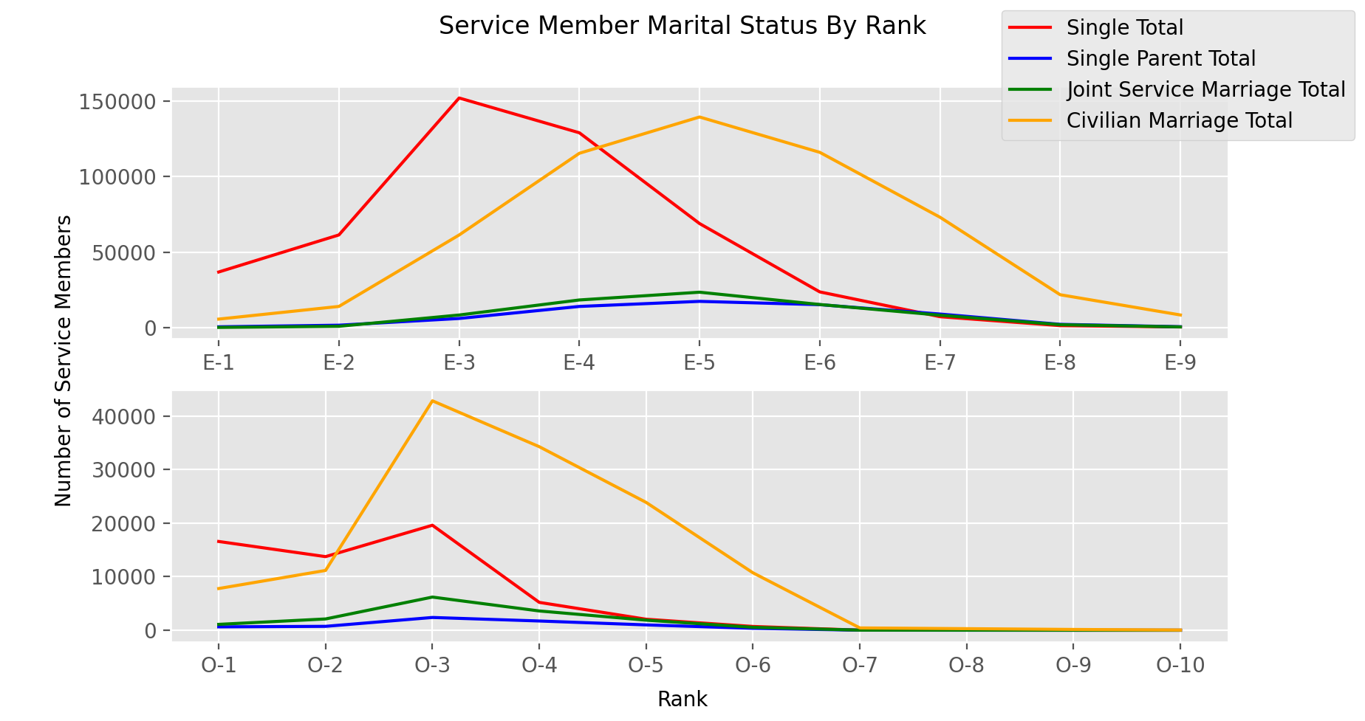

Slide 7
Married vs Unmarried
First I wanted to look at the population of married vs unmarried service members. I used a two sample z-test.
Null hypothesis = The population of married soldiers and unmarried soldiers have a significant statistical difference.
Alternative = The population of married soldiers and unmarried soldiers do not have a significant statistical difference.
Test shows us that there is no significant difference in the number of soldiers that are married against unmarried.
Z test: 0.1
P value: 0.9
Alpha:0.05

Slide 8
Married Enlisted vs Officers
Next let's look at the population of married enlisted vs officers using a two sample z-test again.
Null hypothesis = The population of married enlisted and married officers have a significant statistical difference.
Alternative = The population of married enlisted and married officers do not have a significant statistical difference.
Test shows us that there is no significant difference in the number of enlisted and officers that are married.
Z test: -1.2
P value: 0.2
Alpha:0.05

Slide 9
Single Enlisted vs Officers
Finally we will take a look at the population of single enlisted vs single officers using a two sample z-test.
Null hypothesis = The population of single enlisted and single officers have a significant statistical difference.
Alternative = The population of single enlisted and single officers do not have a significant statistical difference.
Test shows us that there is no significant difference in the number of enlisted and officers that are single.
Z test: -0.6
P value: 0.5
Alpha:0.05

Slide 10
Conclusion
According to the tests one can conclude that we should devote the same effort for married and unmarried service members single the difference between populations is not significant.
In the future I would like to have access to more detailed and recent data. I would have also like to delve into other demographics like age and race.
What is Next?

Slide 11
Questions?
Walter.i.castillo.mil@mail.mil
Github.com/Waltercas

Slide 12
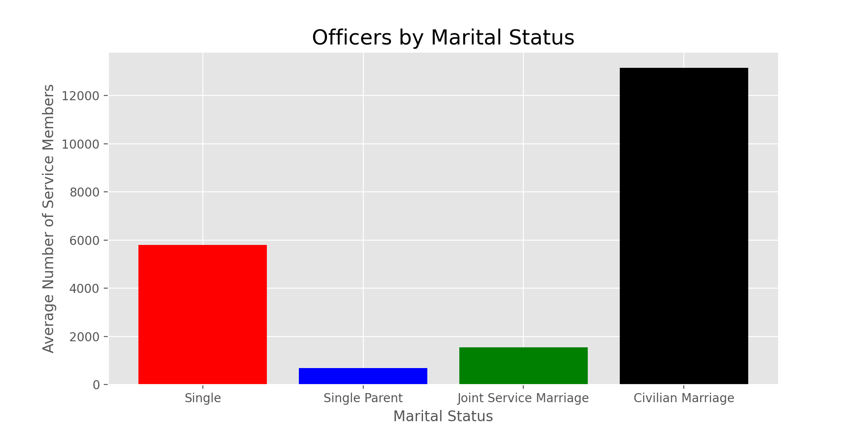

Slide 13
